Slide 1

Herzlich Willkommen
International Energy Engineering | Solar Energy | Prof. Sirag Kartun
Group 1 :- 1. Ashish Manoj Mistari
2. Lakshmikantha Malode Ranganatharao
© 2024 OTH Amberg-Weiden

Slide 2
Agenda
01
Introduction
06
Design of Layout
02
Geogrphical Location
07
Comparison between
PV modules
03
Building Specification
08
Parameter Specefication
04
Project Plan
09
Polysun Result
05
Load Assessment
10
Feasibility Study

Slide 3
1. Introduction
Aim: “To design a cost-effective, efficient solar energy system”.
Objective :
Analysis of the site
Collection and Analysis of data
Forecasting and designing of the solar system
Economic calculations
Selection of the solar system
1

Slide 4
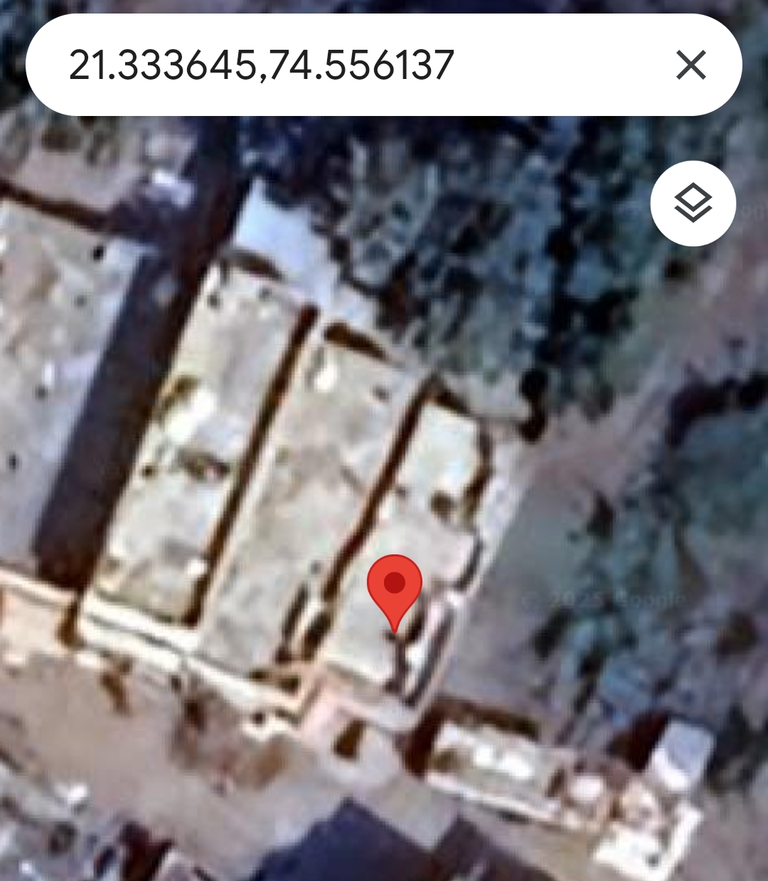
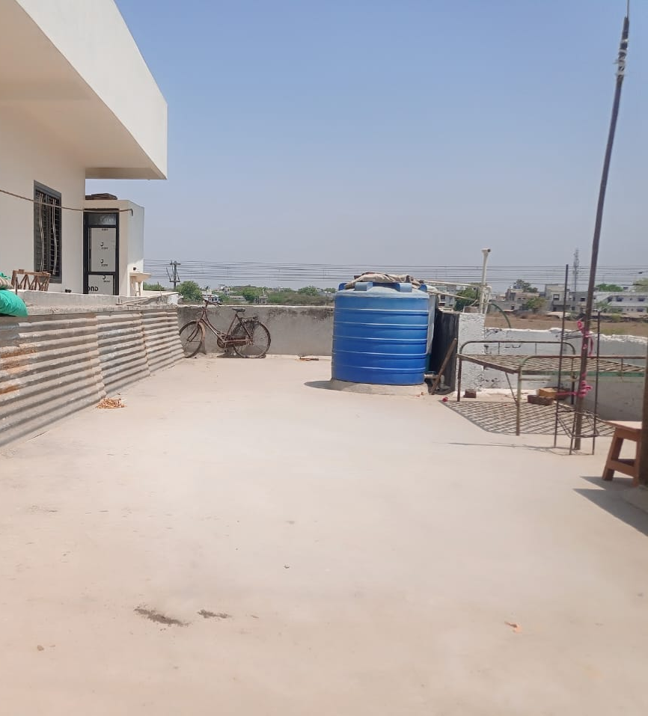
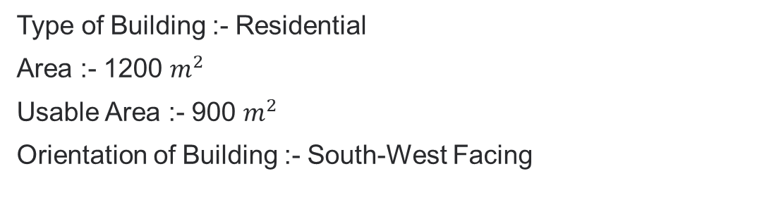
2. Geographical Location
Country :- India
City :- Pune, Maharashtra.
Location Coordinates:- 21°20'01.1"N 74°33'22.1"E
Building type :- 2 Floor Apartment
3. Building Specification
Type of Building :- Residential
Area :- 1200 $m^{2}$
Usable Area :- 900 $m^{2}$
Orientation of Building :- South-West Facing
Source :- https://maps.app.goo.gl/uNLqEW6Sm1UzJp6r9?g_st=aw
2

Slide 5
4. Project Plan
Task | Start Date | End Date | Duration Days | Progress
Study & Planning | 24-Mar | 31-Mar | 7 | Done
Project Initiation | 01-Apr | 08-Apr | 7 | Done
Location Selection | 09-Apr | 23-Apr | 14 | Done
Data Collection | 24-Apr | 08-May | 14 | Done
Feasibility Study | 09-May | 16-May | 7 | Done
Layout Design | 17-May | 31-May | 14 | Done
System Design | 01-Jun | 08-Jun | 14 | Done
Final Design | 09-Jun | 16-Jun | 7 | Done
Presentation Report | 17-Jun | 24-Jun | 7 | Done
3

Slide 6
5. Load Assessment
Electricity Consumption data 2024
Month | Electricity Consumed (kWh)
January | 78
February | 83
March | 107
April | 130
May | 123
June | 140
July | 122
August | 148
September | 100
October | 126
November | 94
December | 86
Total | 1337
Source:- Maharashtra State Electricity Distribution Company Limited Light Bills
4

Slide 7
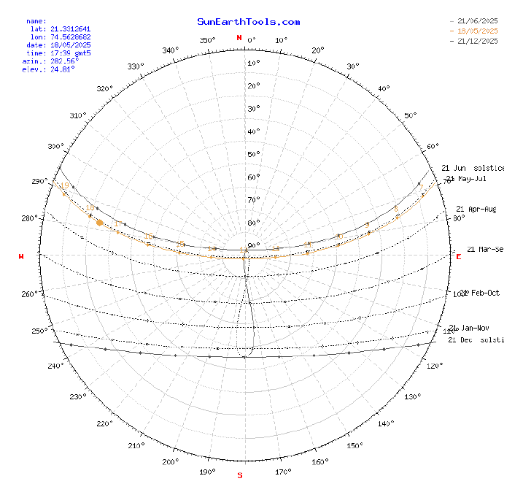
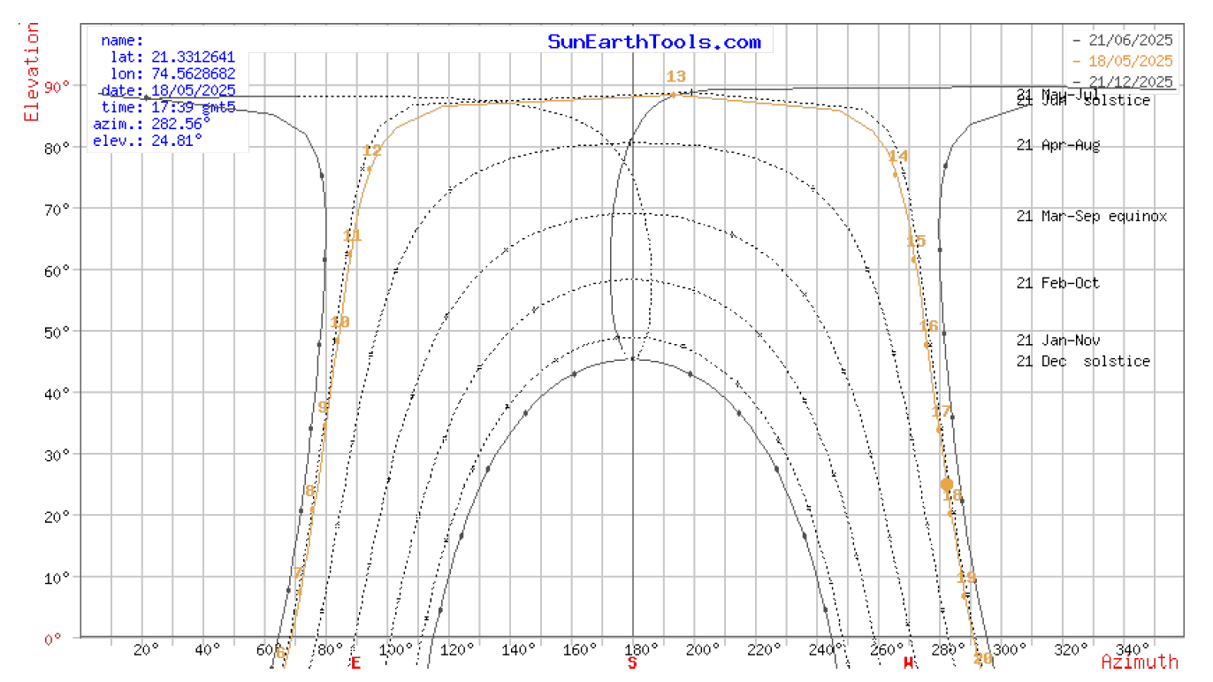
6. Design of Layout
Sun Path Diagram
Source :- https://maps.app.goo.gl/uNLqEW6Sm1UzJp6r9?g_st=aw
5

Slide 8
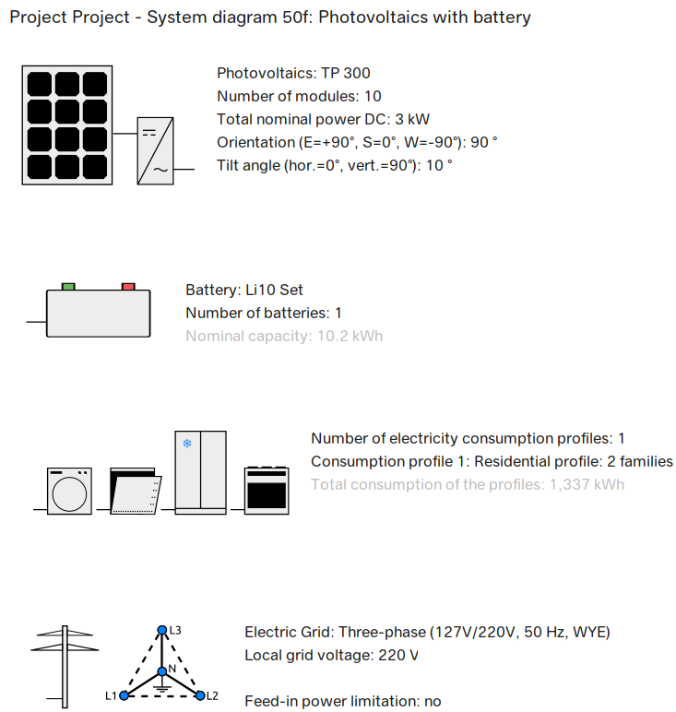
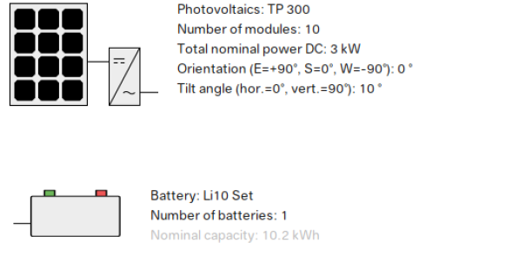
6. Design of Layout (continued)
Software :- Polysun
Source :- Polysun Software
6

Slide 9
7. Comparison
Feature | Polycrystaline | Monocrystaline
Solar Panel Efficiency | Low Efficiency Rate 13% to 16% | High Efficiency Rate 16% to 23%
Appearance | Blue | Black
Cost | Less Expensive | More Expensive
Life Span | 25-35 years | 25-35 years
Temperature Coefficient | Low Temperature Coefficient | High Temperature Coefficient
Durability | Less Durable | Highly Durable
Roof Space | Requires more roof space | Works on Roofs with limited space
Source:- FreyrEnergy_Access Time & Date_17.15_19062025
7

Slide 10
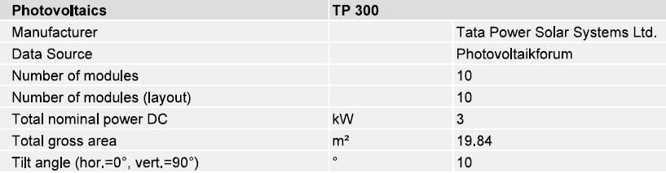
8. Parameter Specification
1. Local Electricity Grid
Electricity Grid :- Three Phase (127V/220V, 50Hz,WYE)
Grid Configuration :- Three Phase star (WYE)
Nominal Voltage :- 220V
Nominal Frequency :- 50Hz
2. PV Module
Source :- Polysun Software
8

Slide 11
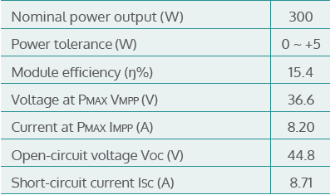
8. Parameter Specification (continued)
Tata Power Solar TP300
Electrical Parameters at Standard Test Conditions (STC)
Electrical Parameters at NOCT
Power Output Pmax (W) | 216.0
Voltage at PMAX VMPP (V) | 32.2
Current at PMAX IMPP (A) | 6.71
Open-circuit voltage Voc (V) | 39.4
Short-circuit current Isc (A) | 7.24
Source:- FreyrEnergy_Access Time & Date_17.15_19062025
9

Slide 12
8. Parameter Specification (continued)
Tata Power Solar TP300
Temperature coefficient characteristics
Operating conditions
NOCT (ºC) | 47 ± 2
Module efficiency (%/ºC) | -0.06 ± 0.01
Temperature coefficient of PMAX (%/ºC) | -0.41
Temperature coefficient of VOC (%/ºC) | -0.32
Temperature coefficient of ISC (%/ºC) | 0.058
Maximum system voltage (UL & IEC) (V) | 1000 & 1000
Maximum series fuse rating (A) | 20
Limiting reverse current (A) | 20
Operating temperature range (ºC) | –40 and +85
Maximum static load (snow or wind) | 113 psf (5400 Pa)
Source:- FreyrEnergy_Access Time & Date_17.15_19062025
10

Slide 13
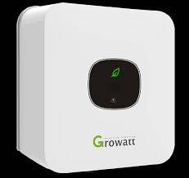
8. Parameter Specification (continued)
3. Inverter
Input Data :-
Max. recommended PV power (for module STC) | 4290W
Max. DC voltage | 550V
Start voltage | 80V
MPP voltage range | 65V-550V
Nominal voltage | 360V
No. of PV strings per MPP tracker | 1
Source :- Inverter_Growatt-MIC3300TL-X2_Access Time & Date_2040_24062025 , Polysun Software
11

Slide 14
8. Parameter Specification (continued)
Growatt MIC 3300TL-X2
Output data (AC)
Efficiency
AC nominal power | 3300W
Max. AC apparent power | 3300VA
Nominal AC voltage(range*) | 230V (180-280V)
AC grid frequency(range*) | 50/60 Hz (45-55Hz/55-65 Hz)
Max. output current | 14.3A
Adjustable power facto | 0.8leading…0.8lagging
THDi | <3%
AC grid connection type | Single phase
Max. efficiency | 97.6%
European efficiency | 97.1%
MPPT efficiency | 99.9%
Source :- Inverter_Growatt-MIC3300TL-X2_Access Time & Date_2040_24062025 , Polysun Software
12

Slide 15
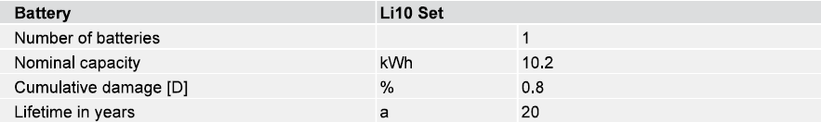
8. Parameter Specification (continued)
4. Battery
Source :- Polysun Software
13

Slide 16
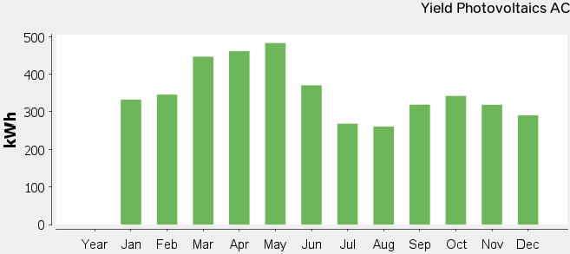
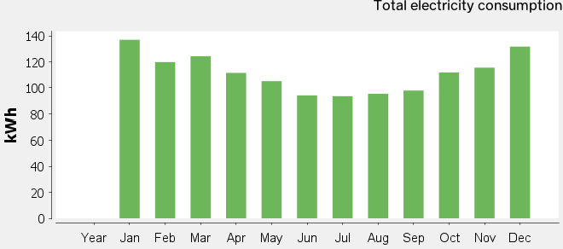
9. Result
Electricity Produced by PV Modules
Electricity Consumption
Source :- Polysun Software
14

Slide 17
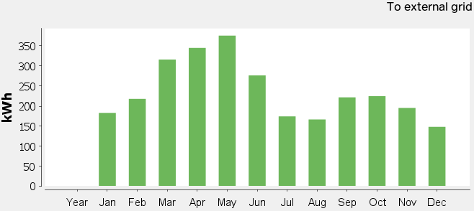
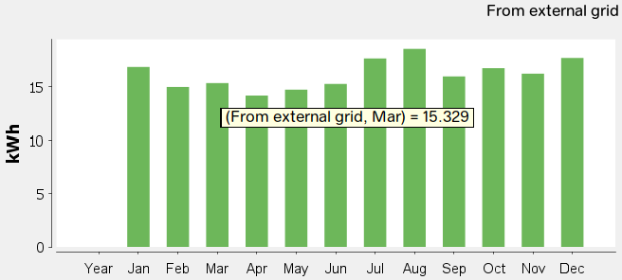
9. Result (continued)
Electricity supplied to the Grid
Electricity from the Grid
Source :- Polysun Software
15

Slide 18
10. Feasibility Study
Funding Schemes under Government of India
Pradhan Mantri Surya Ghar Yojana (PMSG)
  Support benefits 30000 ₹ per kilowatt upto 2 kW power system.
  Additional support 18000 ₹, if system power goes above 3 kW.
  Maximum 78000 ₹ will be supported from Government of India.
  Low interest loan financing from the Bank at 7 % interest rate under 3 kW power PV system.
  These incentive schemes are only for residential households.
Source :- Contral Government Incentives_Access Time & Date_18.45_24062025 ,
16

Slide 19
10. Feasibility Study (continued)
Investment Parameters
PV Module cost | 8700.00 | ₹/Module
Number of Module | 10.00 | Module
Total PV Module cost | 87000.00 | ₹
Inverter Cost | 19500.00 | ₹
Battery Cost | 252000.00 | ₹
Installation Cost | 30.00 | ₹ / W
Total installation Cost | 90000.00 | ₹
Total Lifespan | 27.00 | years
Polysun Data_with battery
Yield Photovoltics | 4245.00 | kWh
Electricity Demand | 1337.00 | kWh
Polysun Data_without battery
Yield Photovoltics | 4469.00 | kWh
Self Consumption | 693.00 | kWh
Energy cost
From grid | 10.00 | ₹
To grid | 3.00 | ₹
Source :- PV module Cost Access Time & Date 11.30_19062025 , Growatt_MIC3300TL-X_Access Time & Date_ 11.45_19062025
17

Slide 20
10. Feasibility Study (continued)
1. CAPEX (without incentive)
CAPEX Calculation with Battery
Appliances | No. of Units required | Per unit cost (₹) | Total Cost (₹)
PV Modules | 10.00 | 8700.00 | 87000.00
Battery | 1.00 | 252000.00 | 252000.00
Inverter | 1.00 | 19500.00 | 19500.00
Installation per W |  | 9000.00 | 90000.00
Total CAPEX |  |  | 448500.00
CAPEX Calculation without Battery
Appliances | No. of Units required | Per unit cost (₹) | Total Cost (₹)
PV Modules | 10.00 | 8700.00 | 87000.00
Inverter | 1.00 | 19500.00 | 19500.00
Installation |  | 9000.00 | 90000.00
Total CAPEX |  |  | 196500.00
2. CAPEX (with incentive)
CAPEX Calculation_with_battery | 370500.00 | ₹
CAPEX Calculation_without_battery | 118500.00 | ₹
Source:- PV module Cost Access Time & Date 11.30_19062025 , Growatt_MIC3300TL-X_Access Time & Date_ 11.45_19062025
18

Slide 21
10. Feasibility Study (continued)
3. OPEX
OPEX Calculation with Battery
Maintenance Cost | 13455.00 | ₹ / a
OPEX Calculation without Battery
Maintenance Cost | 5895.00 | ₹ / a
4. LCOE
LCOE_with_Battery | 6.40 | ₹ / kWh
LCOE_without_Battery | 2.30 | ₹ / kWh
19

Slide 22
10. Feasibility Study (continued)
Condition :- 1 (with Battery 100% Feed In)
Parameter | kWh | ₹ / a | € / a
Self Consumption | - | - | -
Elec. From External Grid | 1337.00 | 13370.00 | 134.82
Feed-in tariff | 4245.00 | 12735.00 | 128.42
Savings | - | -635.00 | -6.40
Condition :- 2 (With Battery 33% consumption based on demand)
Parameter | kWh | ₹ / a | € / a
Self Consumption | 441.21 | 4412.10 | 44.49
Elec. From External Grid | 895.79 | 8957.90 | 90.33
Feed-in tariff | 3803.79 | 11411.37 | 115.07
Savings |  | 6865.57 | 68.65
Payback Period | 53 years
20

Slide 23
10. Feasibility Study (continued)
Condition :- 3 (With Battery 66% consumption based on demand)
Parameter | kWh | ₹ / a | € / a
Self Consumption | 882.42 | 8824.20 | 88.98
Elec. From External Grid | 454.58 | 4545.80 | 45.84
Feed-in tariff | 3362.58 | 10087.74 | 101.72
Savings |  | 14366.14 | 143.66
Payback Period | 25.7 years
Condition :- 4 (Without Battery)
Parameter | kWh | ₹ / a | € / a
Self Consumption | 693.00 | 6930.00 | 69.88
Elec. From External Grid | 644.00 | 6440.00 | 64.94
Feed-in tariff | 3776.00 | 11328.00 | 114.23
Savings |  | 11818.00 | 118.18
Payback Period | 10 years
21

Slide 24
Thank You

Slide 25
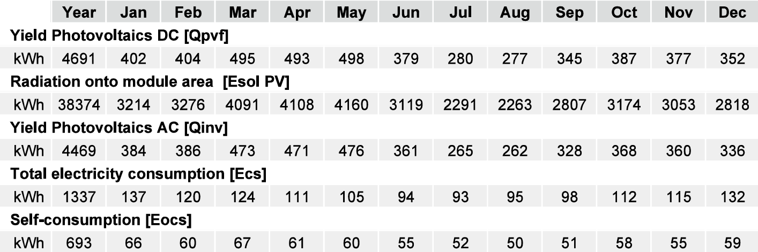
Professional Report Without Battery
Source :- Polysun Software

Slide 26
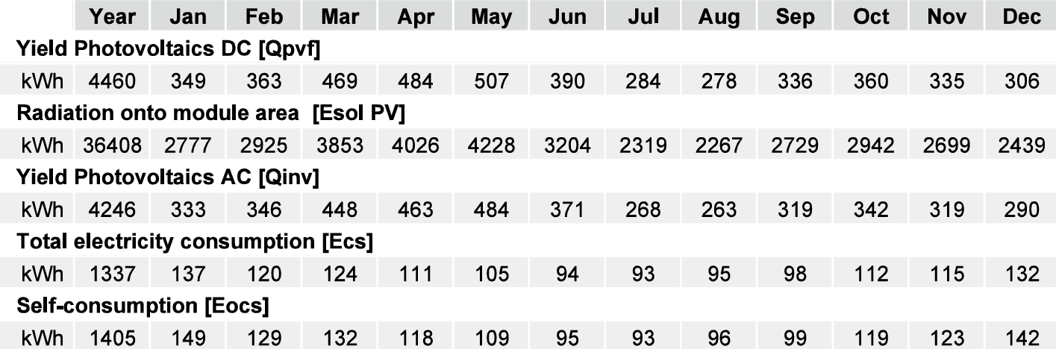
Professional Report With Battery
Source :- Polysun Software

